Slide 1
Amazon Fine Food Reviews
Aayush Agarwal, Megha Gupta, Ying Pan, Russell Nour

Slide 2
AGENDA
01 Business Objective
04 Evaluation
02 Data Overview
05 Deployment
03 Methodology

Slide 3
01
Business
Objective

Slide 4
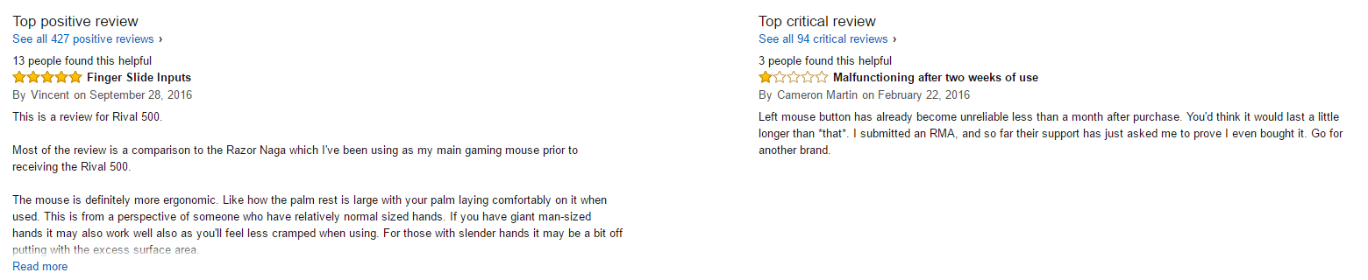
01
Business Objective
SENTIMENT ANALYSIS
LOGIC REGRESSION MODEL
Classify user reviews as positive or negative sentiment
Amazon can classify user reviews into positive & negative buckets

Slide 5
02
Data
Understanding

Slide 6





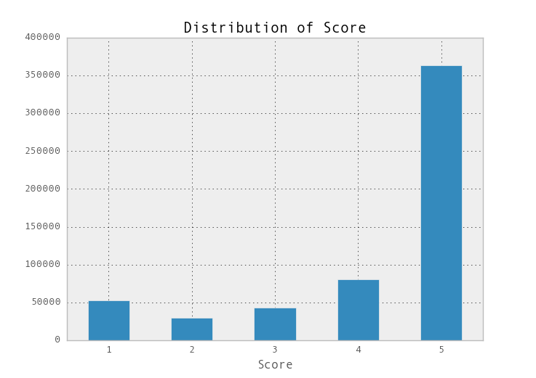
02
Data Understanding
Data
Obtained from Kaggle & SNAP (Stanford Network Analysis Project)
568,454
reviews
256,059
users
74,258
products
Oct 1999
Oct 2012
User Rating (1 – 5)
Text (User Review)

Slide 7
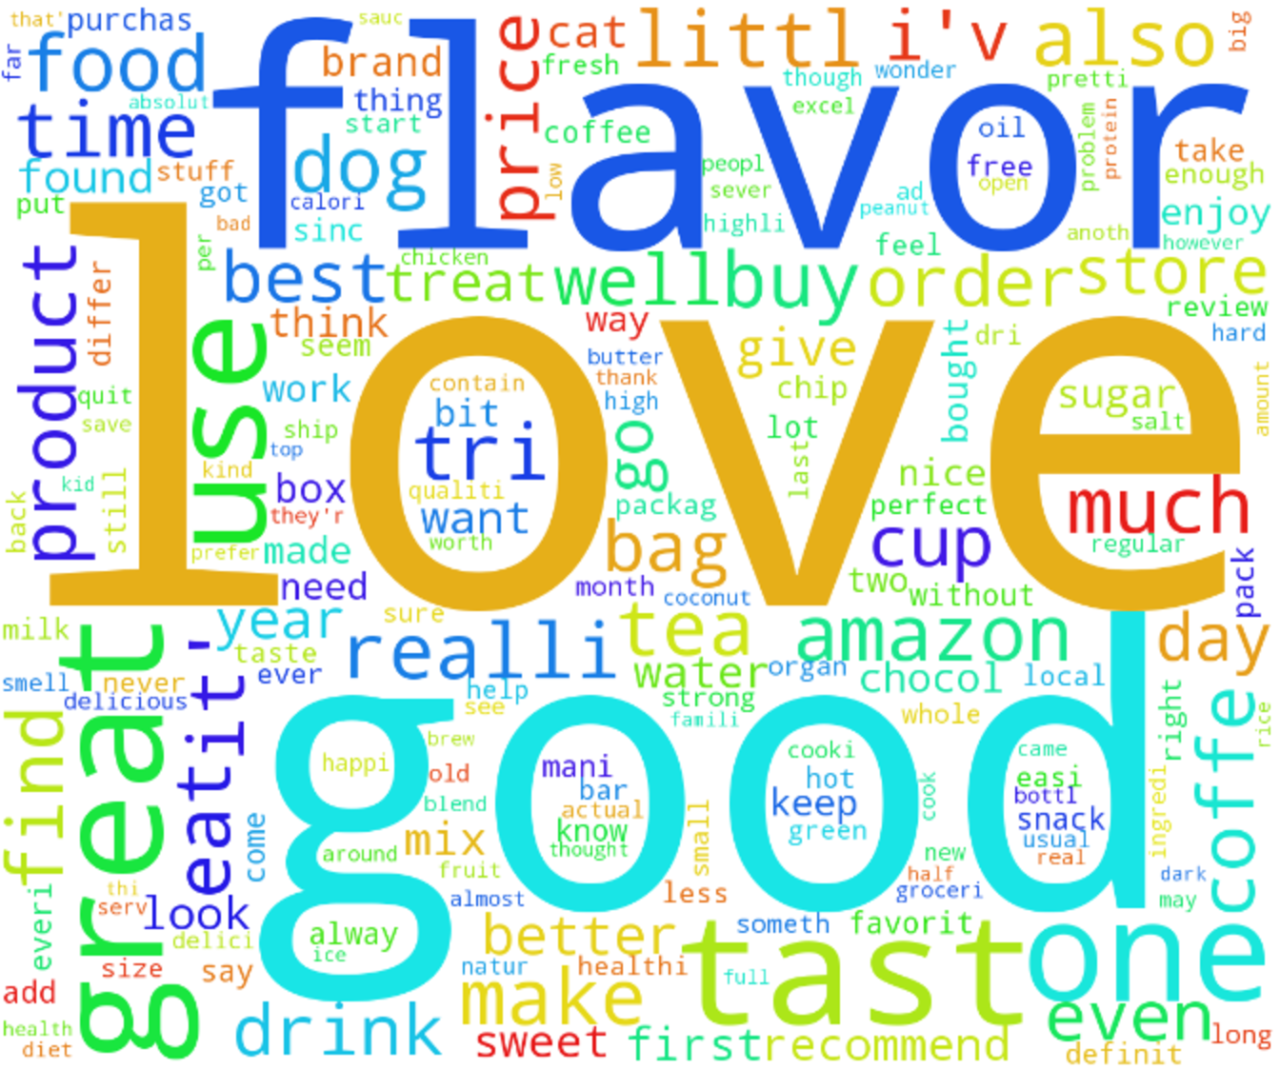
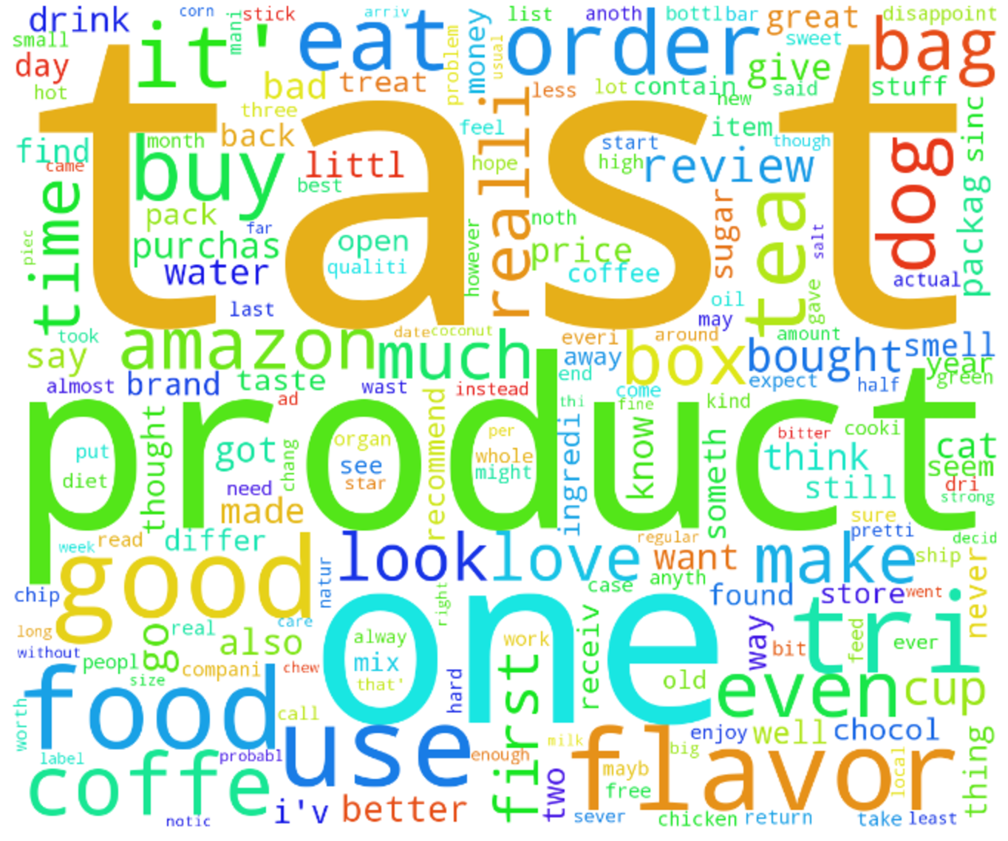
02
Word Cloud

Slide 8
03
Methodology

Slide 9

03
Methodology
Step 1
Step 3
Data Manipulation
Modeling
Filter neutral reviews
1,2 → Negative(0)
4,5 → Positive (1)
Classifying each review as positive or negative sentiment based on the text
Step 2
Step 4
Text Mining
Deployment
Case Normalization
Tokenize
Stop words removal
Stemming
TF-IDF
AWS
Spark + Hadoop Cluster

Slide 10



03
Step 1
Data Manipulation
1
Filter Neutral Reviews
Convert Scores Into Binary
2
Score = 3
= 1
= 0

Slide 11
03
Step 2
Text Mining
1
I have bought several of the vitality canned dog food
2
Case
Normalization
i have bought several of the vitality canned dog food
3
3
Tokenize
‘i’ ‘have’ ‘bought’ ‘several’ ‘of’ ‘the’ ‘vitality’ ‘canned’ ‘dog’ ‘food’
4
Stop Words
Removal
‘have’ ‘bought’ ‘several’ ‘vitality’ ‘canned’ ‘dog’ ‘food’
5
Stemming
'bought’ ‘sever’ ‘vital’ ‘can’ ‘dog’ ‘food’
TF-IDF
Sparse Metrics

Slide 12

03
Modeling
点击此处添加标题
Logistic Regression
Gradient Boosting Tree
Naïve Bayes
1
2
3

Slide 13
04
Evaluation

Slide 14
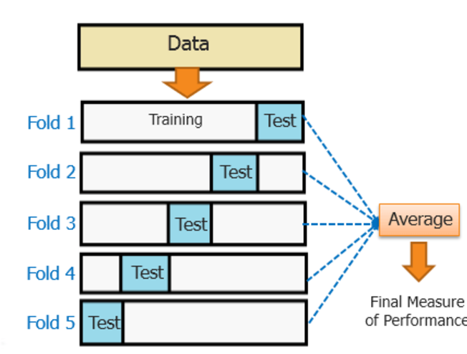
04
Evaluation
Parameter Grid
Cross Validation
Best Performance
95.6%
LR - Regularized parameter
Naïve Bayes - Smoothening parameter
GBT - Maximum Iterations

Slide 15
05
Deployment

Slide 16



05
Deployment
Store
Cluster
Analyze

Slide 17
THANK YOU !
Question?

